Slide 1
Truck Platooning
Autonomous Systems Lab A
Group members
Andrey Sysoev
Sadim Rahman Badhan
Daria Shushkova

Slide 2
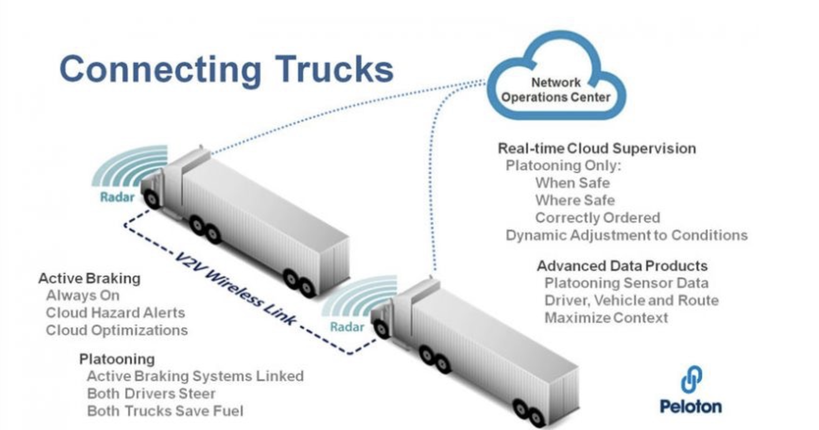
Motivation
Efficiency: reduce fuel consumption
Road capacity: use road space more efficiently
Safety: reduce human-error accidents
www.peloton-tech.com

Slide 3
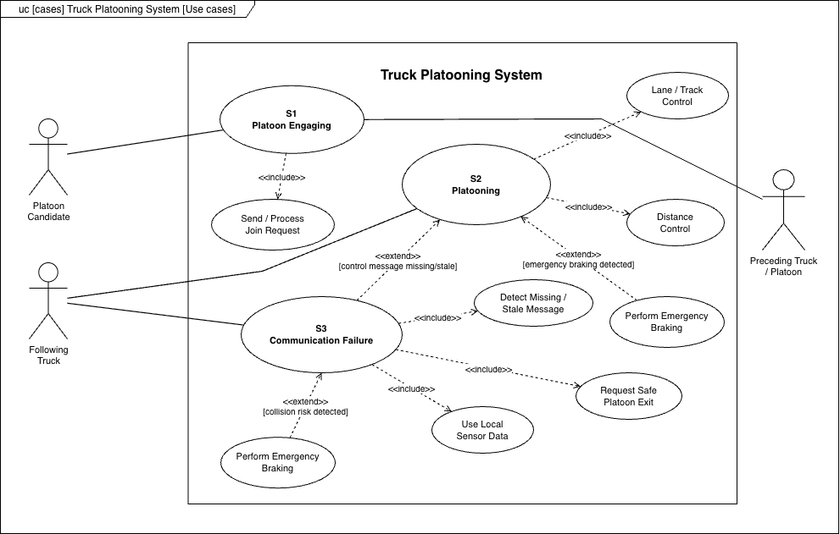
Scenarios
ID | Scenario
S1 | Platoon Engaging
S2 | Platooning
S3 | Communication Failure

Slide 4
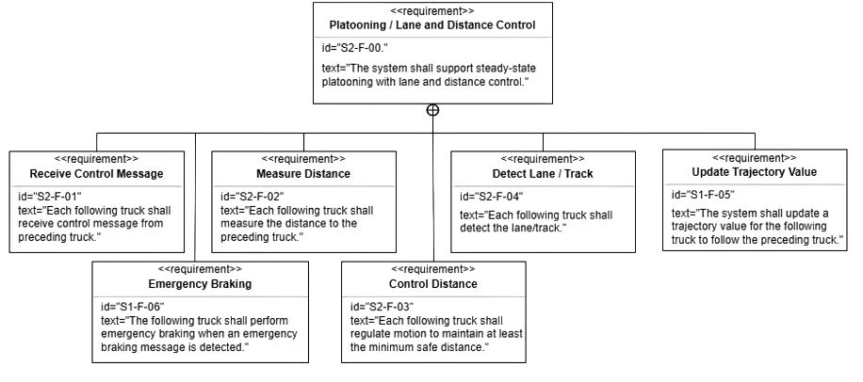
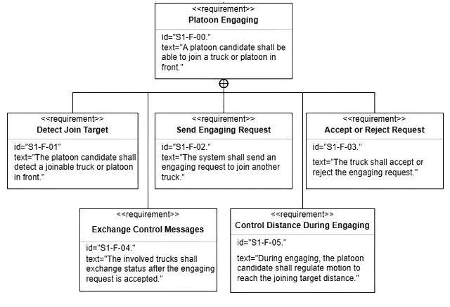
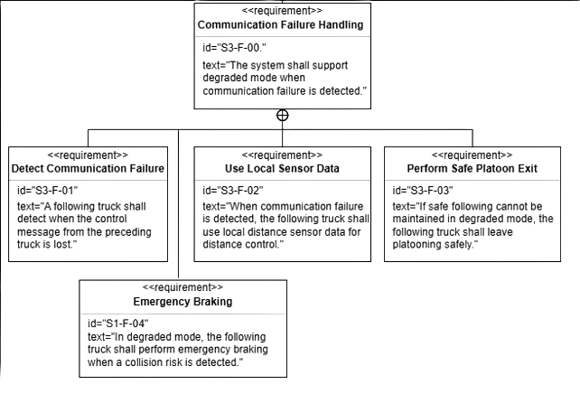
Functional Requirements

Slide 5
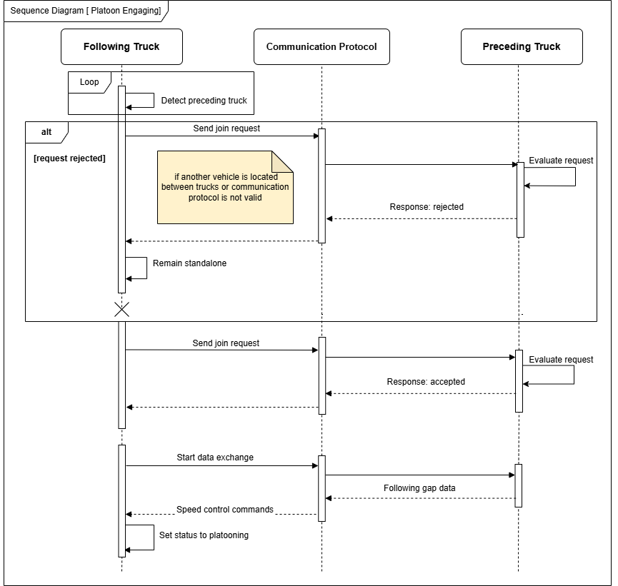
Platoon Engaging

Slide 6
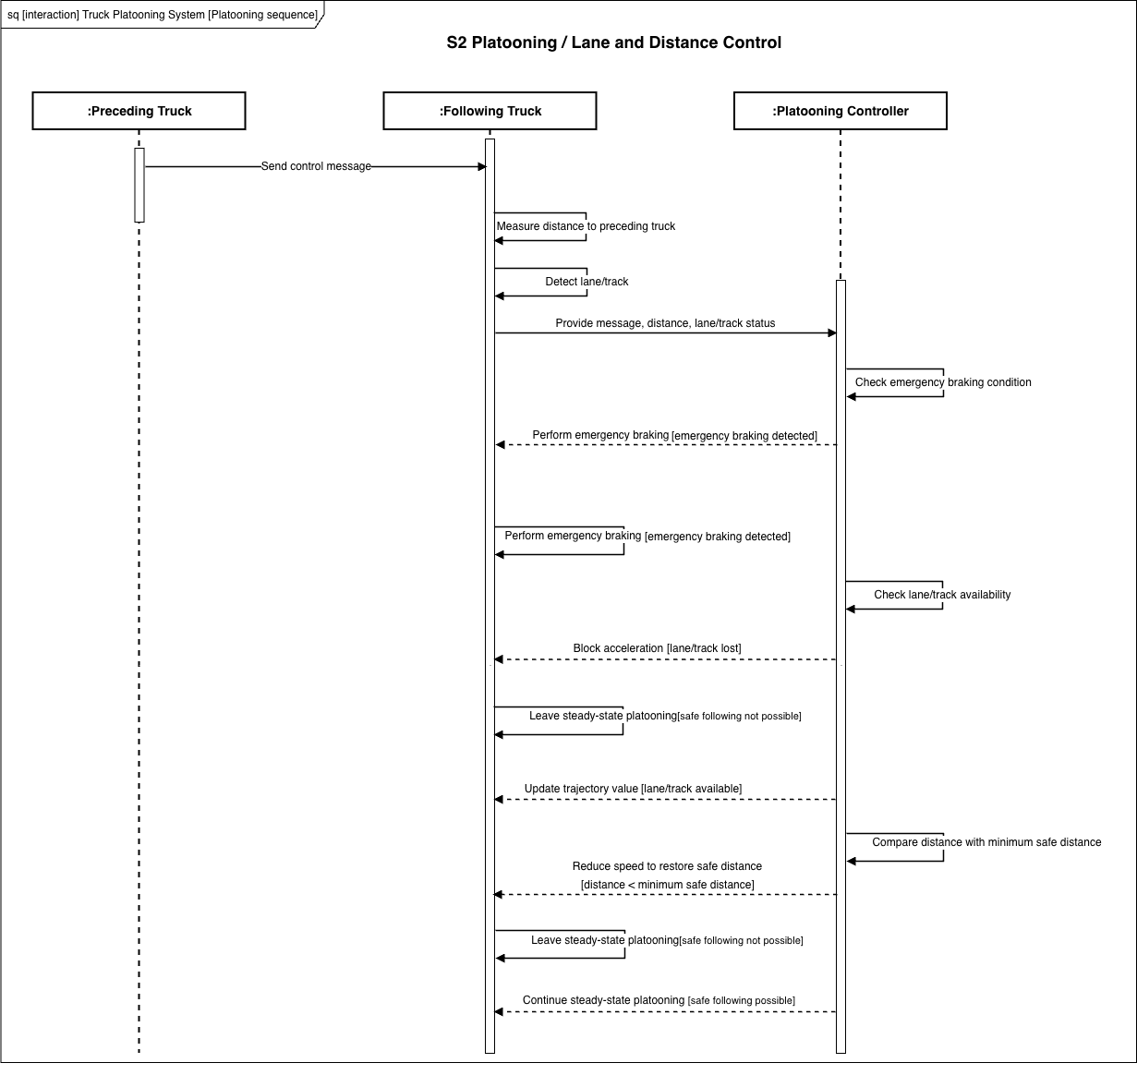
Platooning

Slide 7
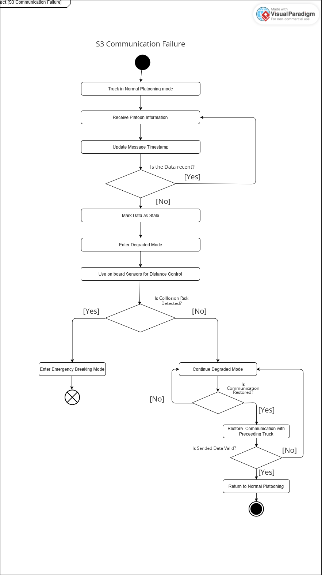
Communication failure

Slide 8
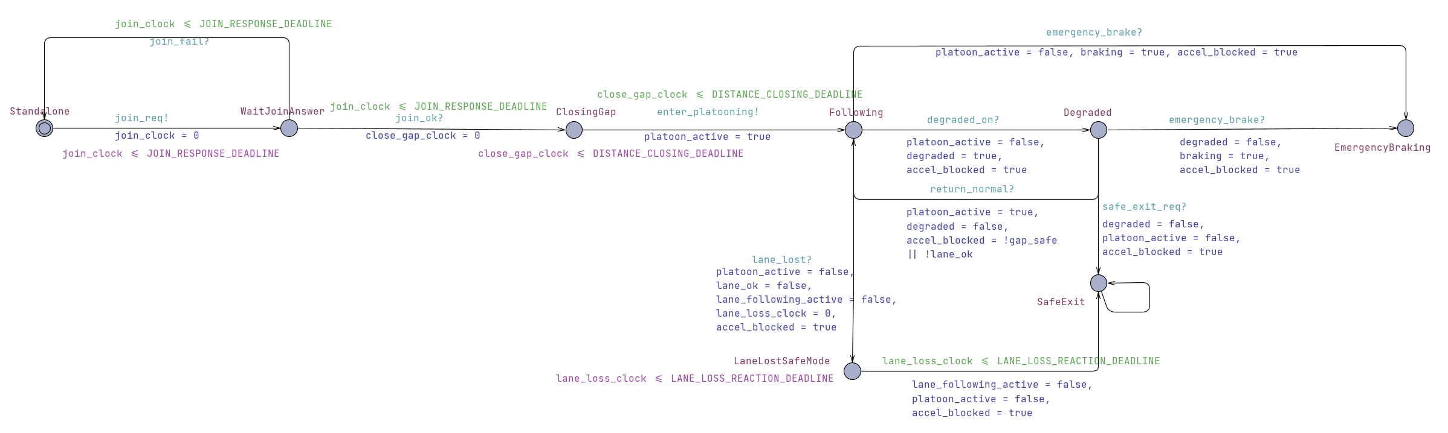
Truck Engaging

Slide 9
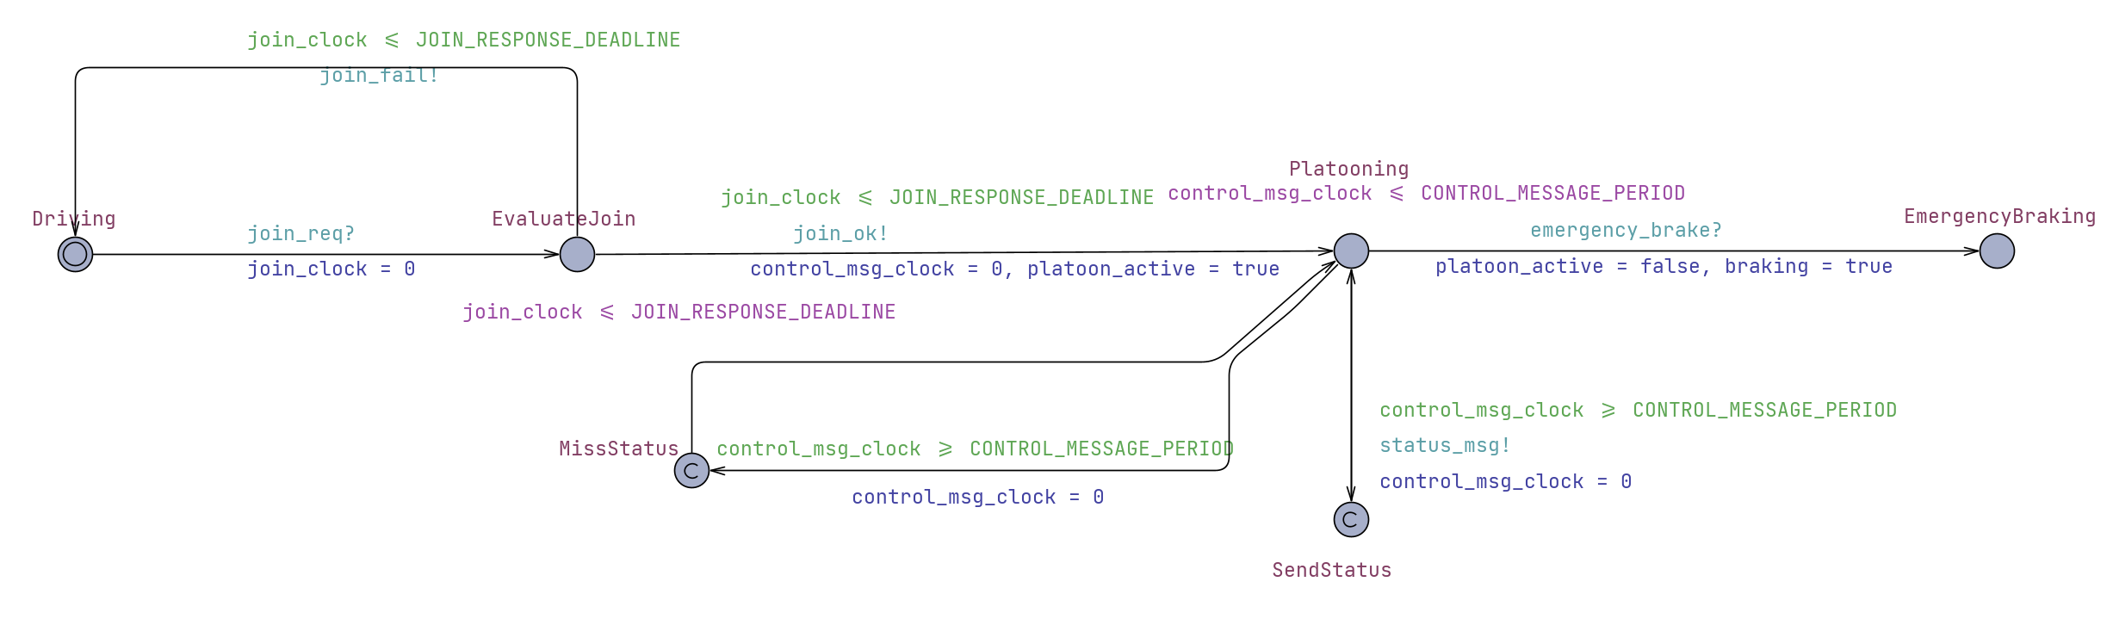
Platooning

Slide 10
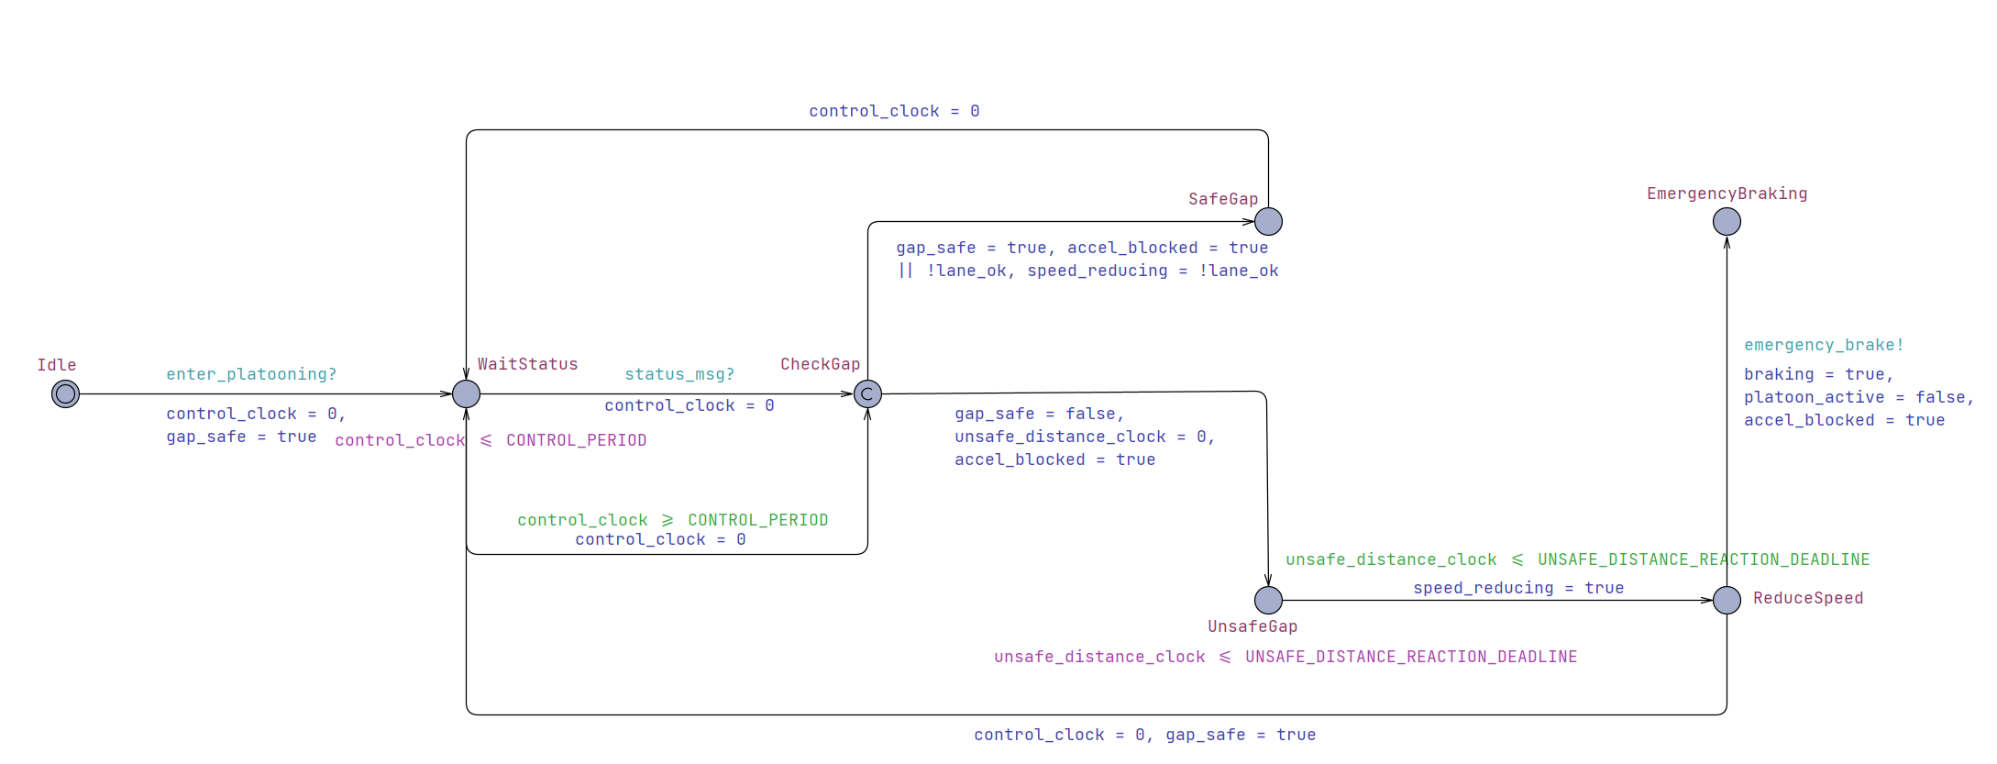
Safety Model

Slide 11
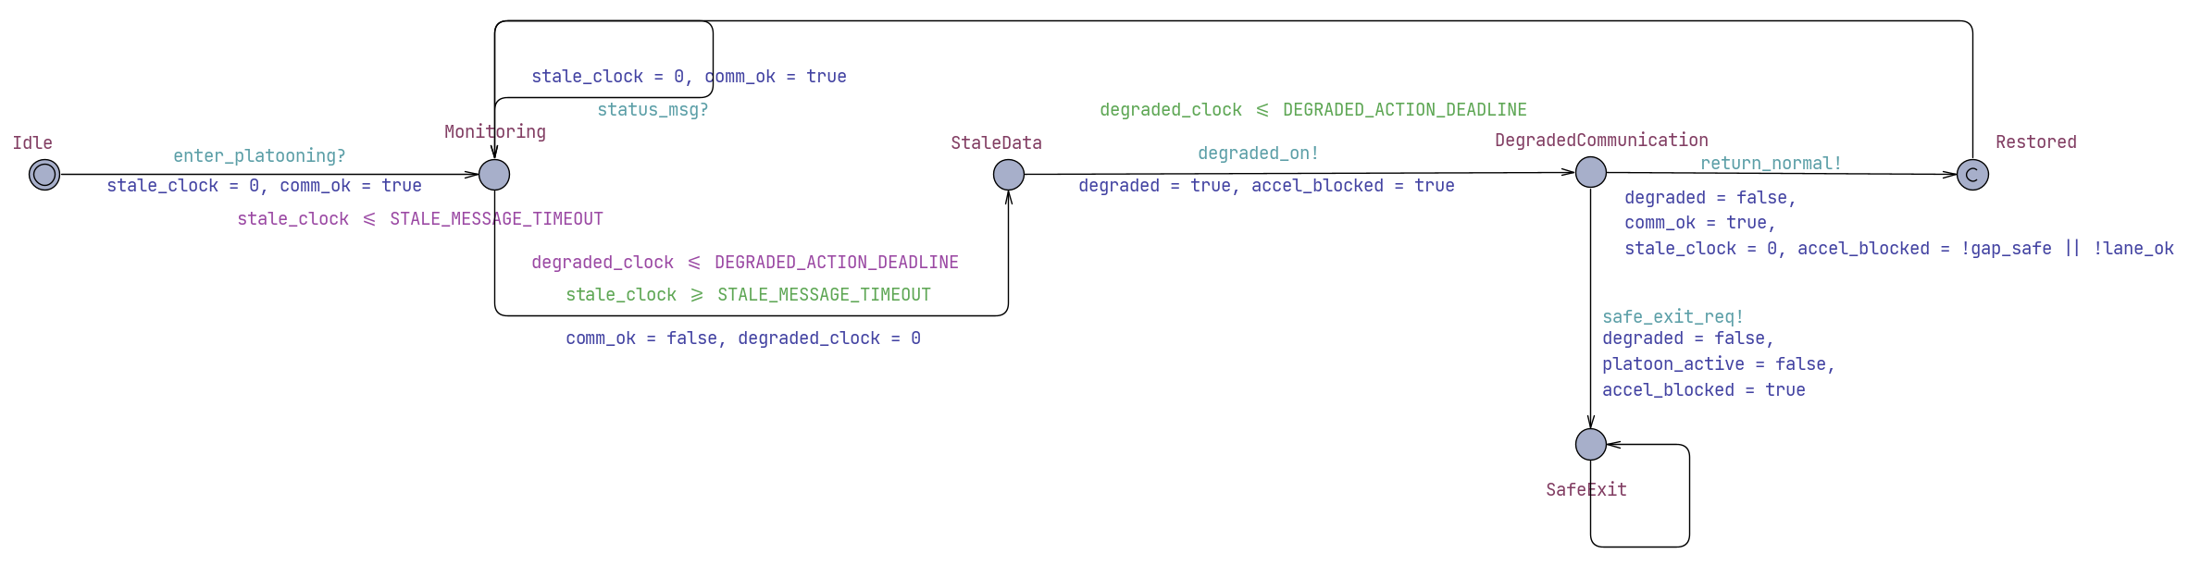
Communication Failure

Slide 12
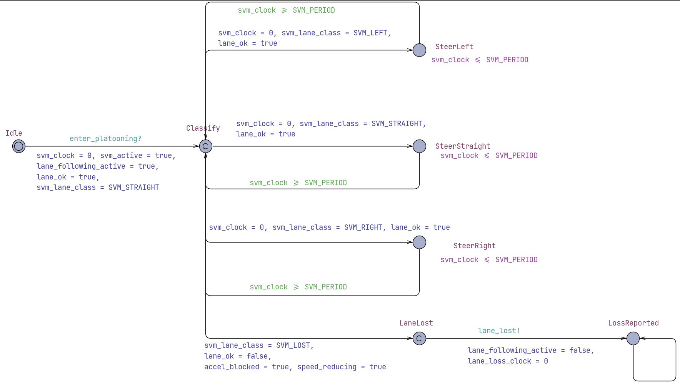
SVM

Slide 13
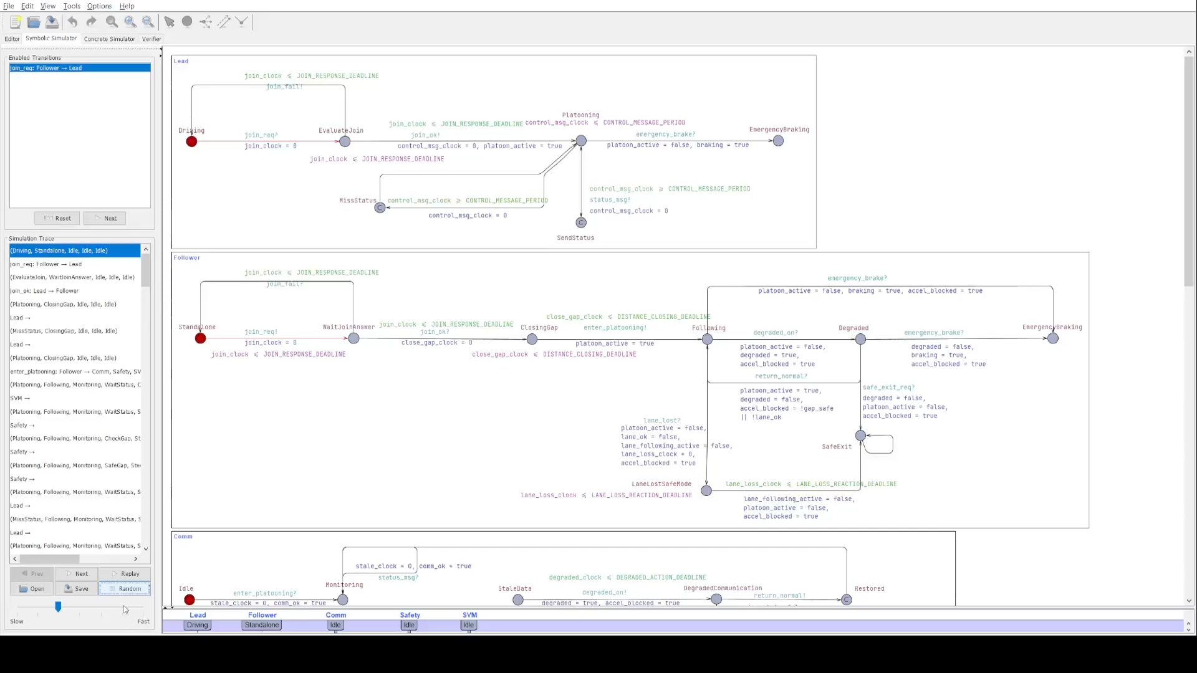
UPPAAL Simulation

Slide 14
Machine Learning Implementation

Slide 15
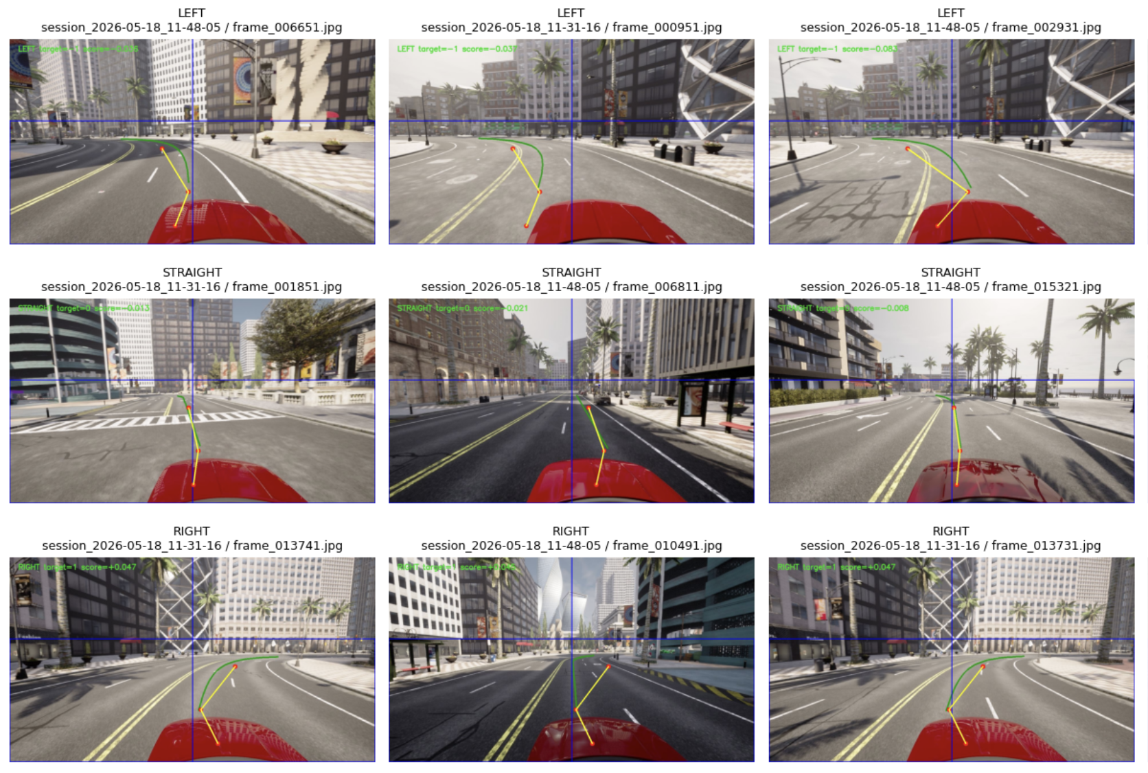
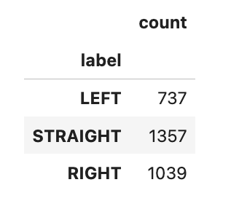
Dataset

Slide 16
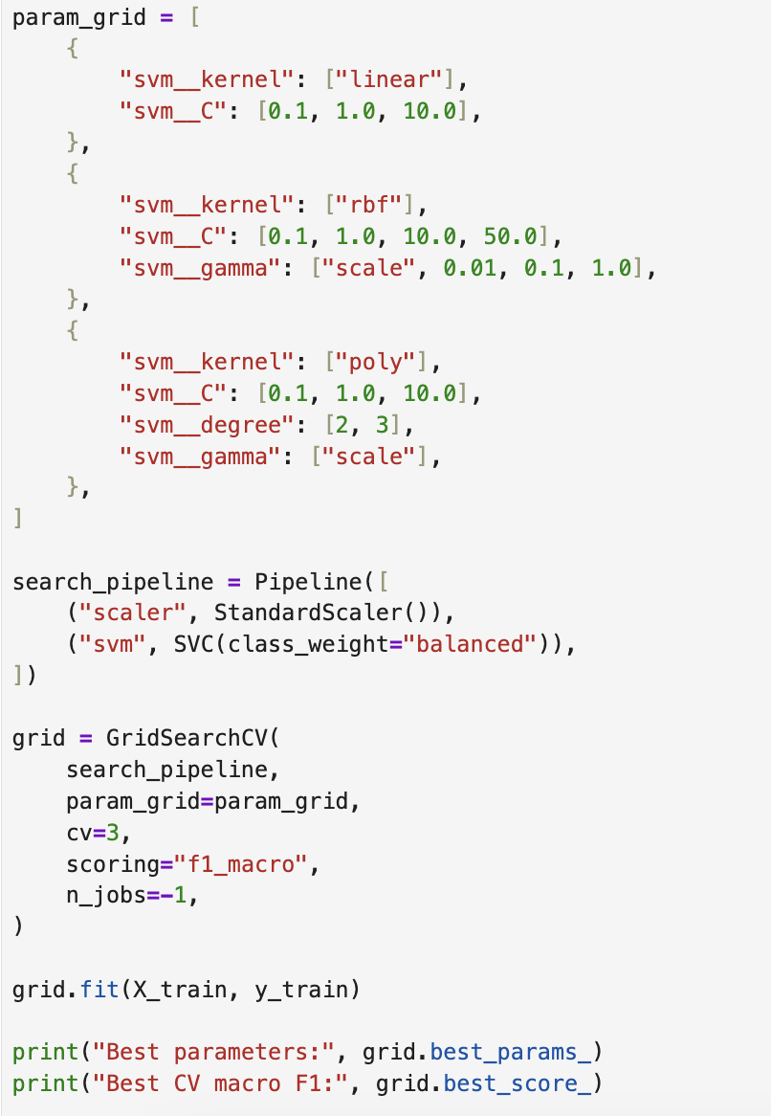
Best Model Selection
Linear SVM with C parameter search
RBF SVM with C and gamma parameter search
Pipeline to prevent data leakage
Feature scaling to standardize values

Slide 17

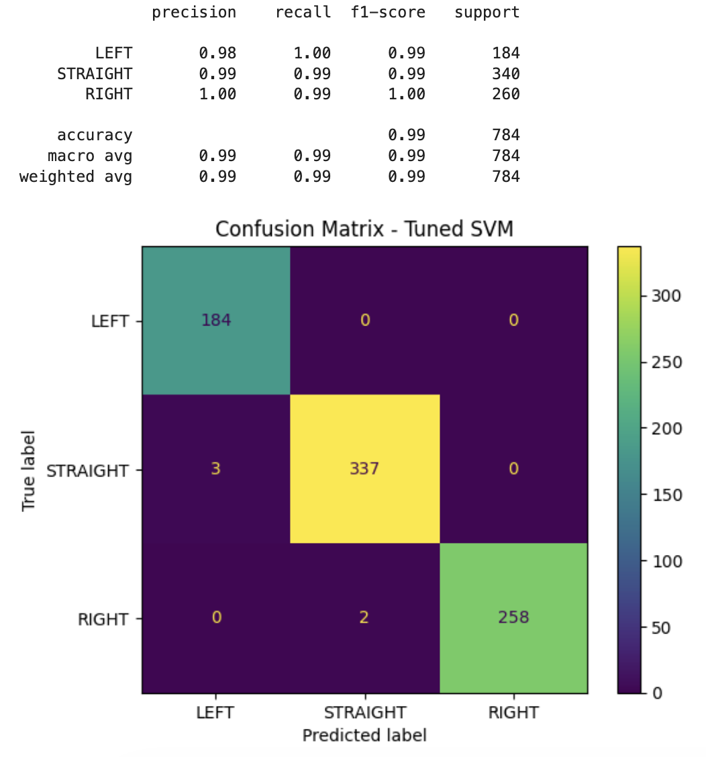
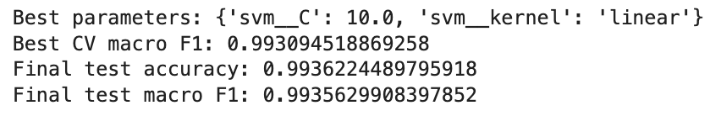
Best Model Evaluation

Slide 18
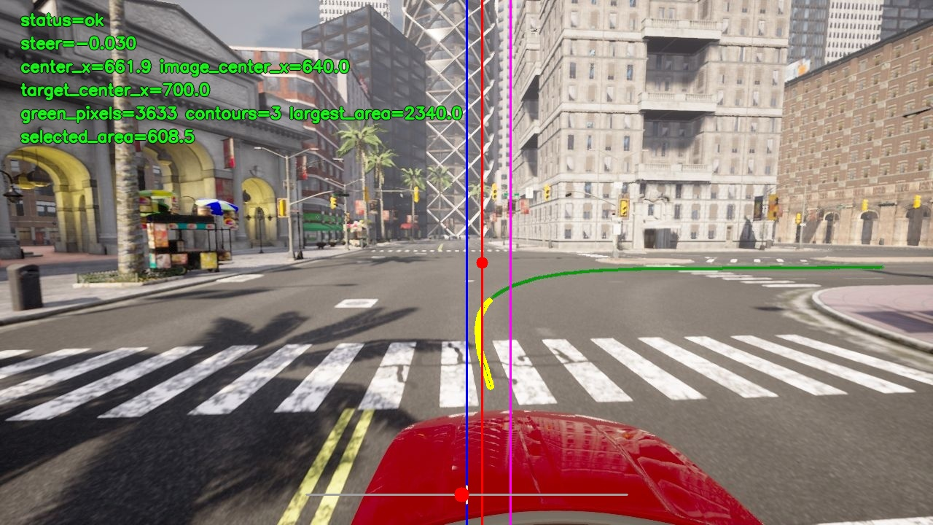
Results
Trajectory value correctly generated
Green noise eliminated
Lane successfully detected

Slide 19
Conclusion
Future improvements:
SVM
The SVM task classified CARLA line-following frames into LEFT, STRAIGHT, and RIGHT with high test performance.
Add more realistic vehicle dynamics
Add model communication latency.
Test SVM on larger datasets with different conditions.
Connect the SVM perception output directly with the platooning controller.
Scenarios
The truck platooning part defined scenarios, requirements, timing assumptions.
UPPAL
UPPAAL was used to check deadlock in system and safety measurements.

